Slide 1
TASK 3
DATA ANALYSIS
BY-YUKTA VIVEK NAIK
TOOL USED- POWER BI
DATASET- SUPERSTORE ORDERS…(from kaggel)

Slide 2
DATASET OVERVIEW
DATA SOURCE: Kaggle
MAIN COLUMS: Order ID, ORDER Date, Shipping Date, Region, Country, Product, Segment, Category, Sub-category, Profit, Sales, Quantity ETC
Steps to export dataset: EXPORT TO POWERBI -> CHOOSE CVC/TEXT -> TRANSFORM

Slide 3
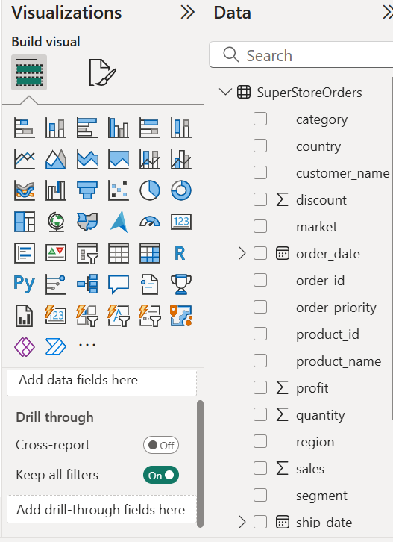
STEPS FOR VISUALISATION
EXPORT DATA-> TRANSFORM(remove duplicate n blank coloum and check data type) -> CLICK CLOSE AND APPLE-> LOAD
VISUALISATION BAR-> CHOOSE TYPE OF VISUAL -> CHOOSE APPROPRAITE FIELDS
FOR TIME SERIES LINE CHART-> X-AXIS(oder date) Y-axis(Sum of profit and sales) THEN
CHOOSE SLICER-> FIELDS (DATE,REGION CATEGORY)-> APPLE AS NEEDED
-PICTURE OF VISUALIZATION BOX

Slide 4
Visuals on dashboards
KPIs
SALES TRENDS
TIMESERIES ANALYSIS
SLICES/FILTERS
PIE CHARTS
BAR CHART

Slide 5
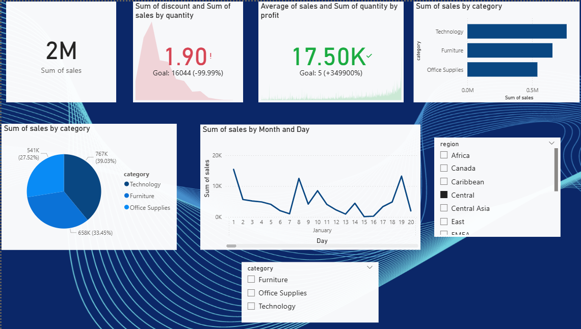
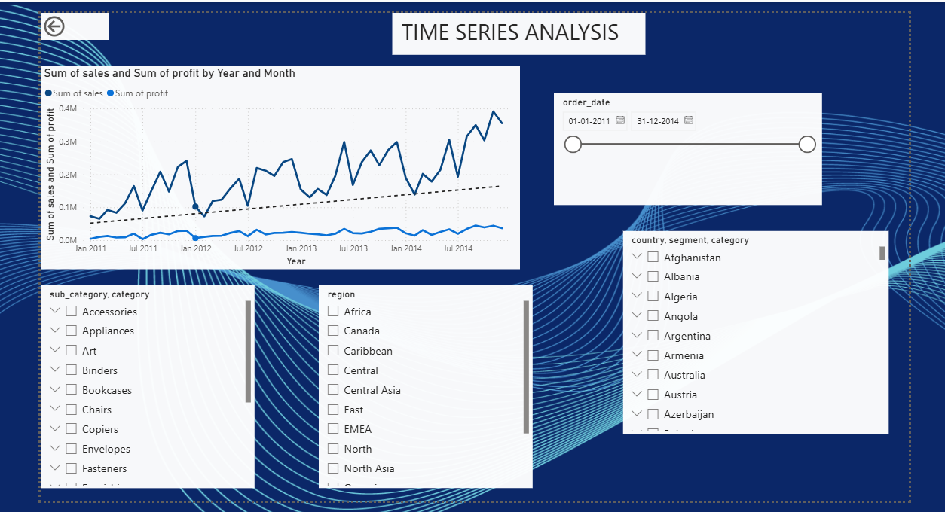
PICTURE OF DASHBOARD OF POWER BI

Slide 6
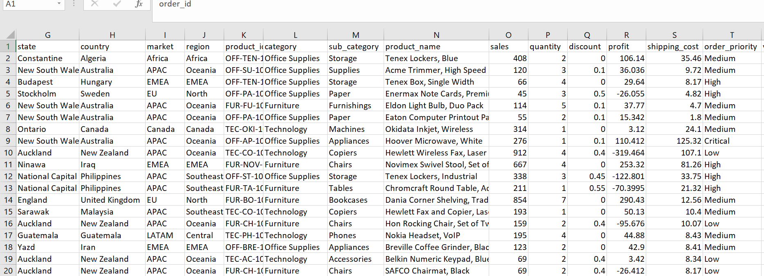
PICTURE OF DATASET

Slide 7

CONCLUSION
The store achieved a total sales revenue of $7.83 million with a net profit of approximately $1.47 million
Office Supplies generated the highest sales volume, while Technology delivered the highest profit margin, indicating strong demand and profitability in tech-related products.
The Central region emerged as the top-performing area in terms of profit contribution,
The average shipping cost is $26.38 per order, indicating manageable distribution expenses that likely support overall profitability and customer satisfaction.

Slide 8
Thank you

